Slide 1
Object Detection Inference on PYNQ-Z2
電子碩一 范詠為
資工碩一 吳泓毅
電子碩一 林子軒

Slide 2
Outline
YOLOv1 Intro
System Flow
Dataset
Implementation & Encountered Problem
model architecture & experiment
non maximum suppression
vivado ip flow (stitich model IP & nms IP)
host program
Conclusion
Reference

Slide 3
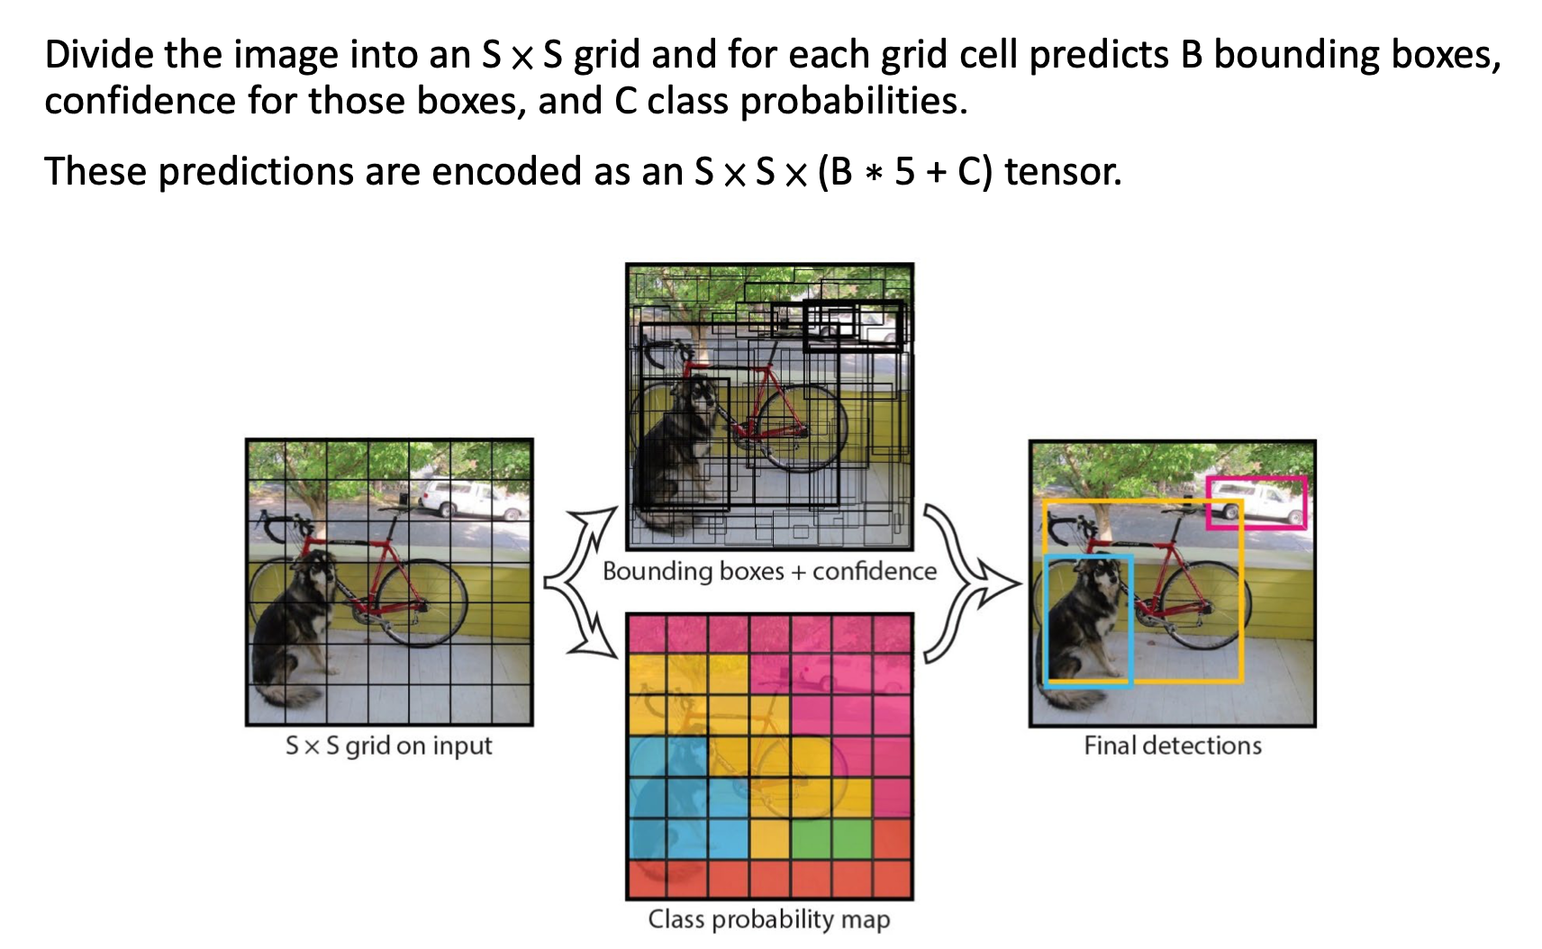
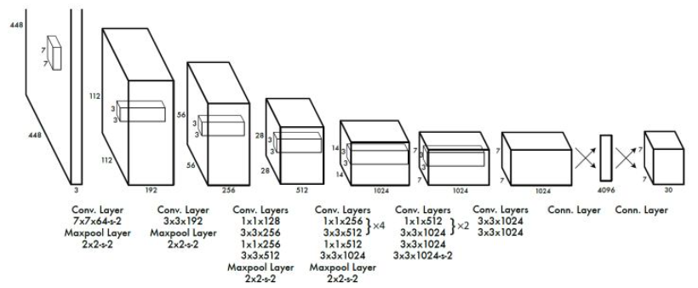
Object Detection – YOLOv1
An one-stage frameworks for object detection task

Slide 4
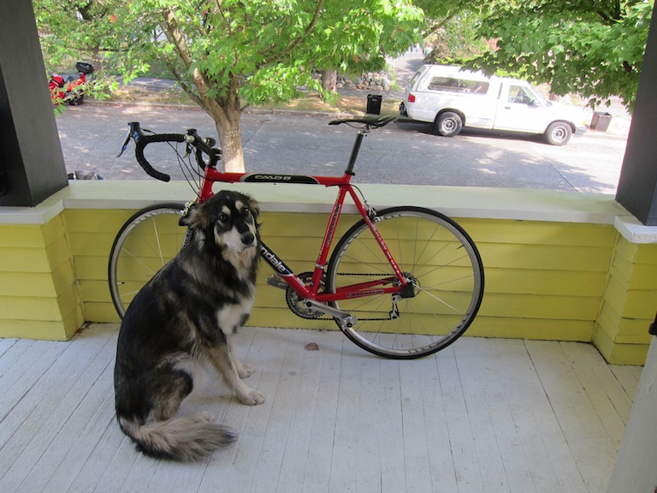
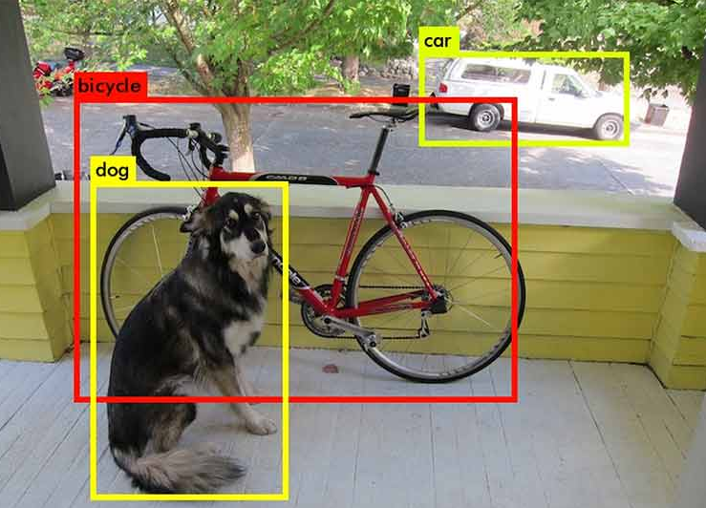
System Flow (on PYNQ-Z2)
PS
image preprocessing
image blending
3xHxW
3xHxW
3x48x48
class,score,x,y,h,w
PL
NN model
NMS
SxSx(5B+C)

Slide 5
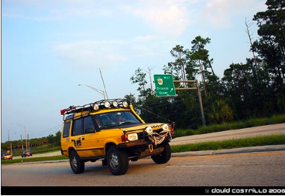
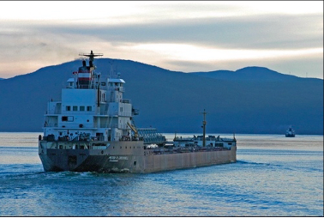
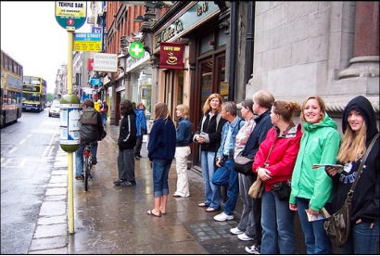
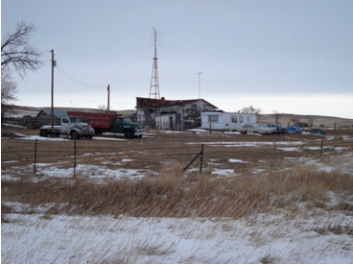
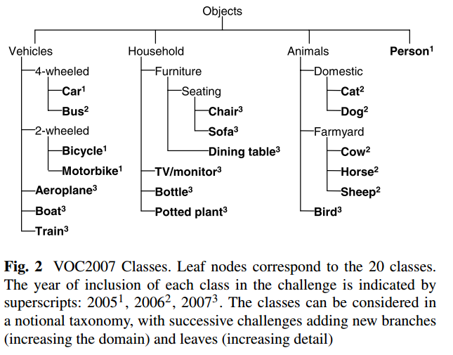
Dataset
PASCAL Visual Object Classes (VOC):
year 2007
20 classes.
2501 images
Using training set to train and validation:
YOLOv1 needs pretrained weights to prevent overfitting, but due to time restriction, we didn’t pretrained on other dataset like COCO or ImageNet on our model to get pretrained weights and do transfer learning on VOC dataset.

Slide 6
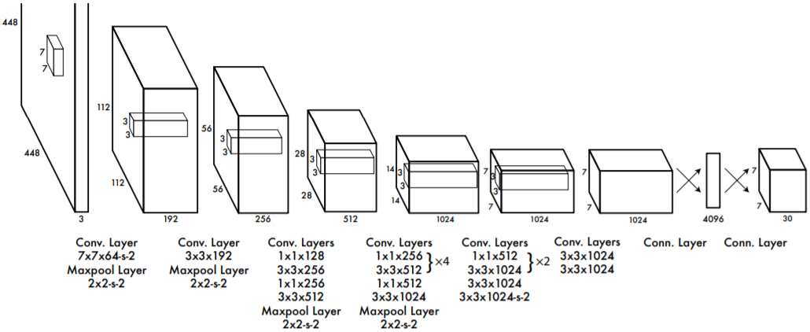
Model Architecture
Image size is 448x448
24 Conv Layer + 2 fully connected Layer
The last layer need 4096x(7x7x30) = 6021120 parameters

Slide 7
Model Compression
Change image size from 448x448 to 48x48 for lower inference time
Change 24 Conv Layer + 2 fully connected Layer to 4 Conv Layer and 1 fully connected Layer
Shrink dimension of last layer from 7x7x30 to 3x3x30, now it needs (3x3x32)x(3x3x30) = 77760 parameters, which is much smaller than 6021120 parameters
z
If we remove one box, number of parameters change from 7x7x30 to 7x7x(30-5)=1225
If we shrink grid size to 3x3, number of parameters change from 7x7x30 to 3x3x30=270
20(class confidence score)
5 (box coordinate and confidence score)
5 (box coordinate and confidence score)

Slide 8
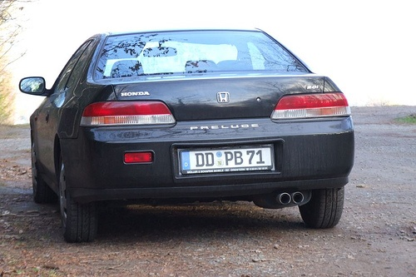
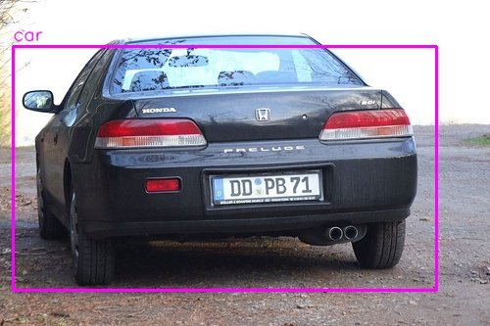
Model Architecture
Conv + MaxPool
Conv + MaxPool
Conv + MaxPool
Fully Connected
Conv + MaxPool
NMS
48x48x3
24x24x64
12x12x64
6x6x64
3x3x32
3x3x30

Slide 9
Experiment
Model | mAP(PC side) | mAP(PYNQ-Z2 side)
3W3A | 50.9% | 37.7%
4W4A | 70.2% | 52.1%
5W5A(lower PE and SIMD) | 91.9% | 68.2%

Slide 10
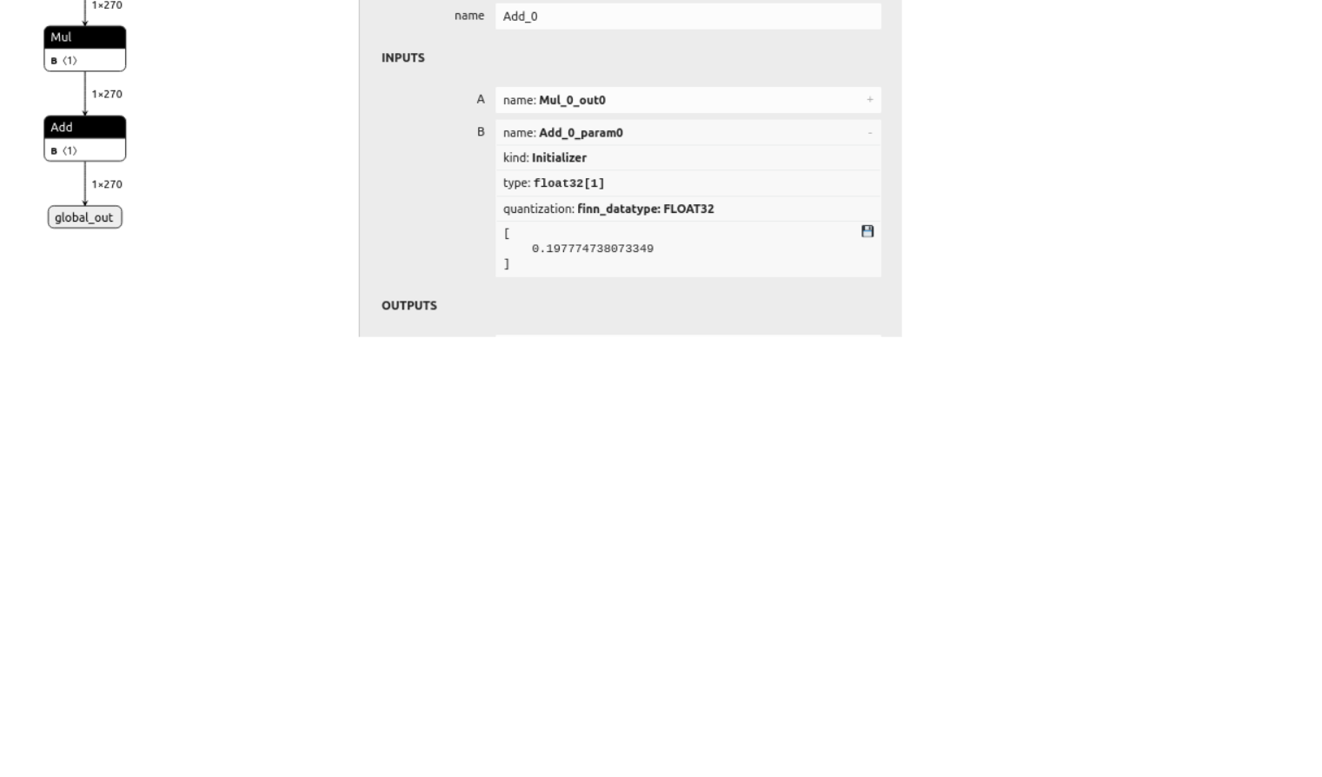
Problem encountered and Solved
Problem: Output of model is integer because of BNN, but it is expected to be small floating point.
Solved: When we transfer onnx to finn support layer, the last operation which let integer to be floating point will be removed. So we need to do postprocessing by ourselve to let model’s output value reasonable.
output of model on FPGA
after postprocessing
[-516,-3585,-5,-475…..]
[0.0838, -0.5943,0.19677, 0.09283]
transfered by ourselves

Slide 11
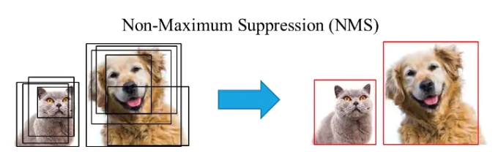
Non Maximum Suppression (NMS)
select best bounding boxes out of many overlapping bounding boxes
remove bbox with score < score_th
sort by score from highest to lowest
while bboxes list is not empty
pop one bbox (B1), keep other bbox (B2) in list if
B1 and B2’s predicted class are different
B1 and B2’s predicted class are same and iou(B1, B2) < iou_th
append B1 to final return list
bounding box (bbox)
(class, score, x, y, h, w)

Slide 12
Non Maximum Suppression (NMS)
select best bounding boxes out of many overlapping bounding boxes
remove bbox with score < score_th
sort by score from highest to lowest
while bboxes list is not empty
pop one bbox (B1), for other bboxes (B2), keep B2 in list if
B1 and B2’s predicted class are different
B1 and B2’s predicted class are same and iou(B1, B2) < iou_th
append B1 to final return list
bounding box (bbox)
(class, score, x, y, h, w)

Slide 13
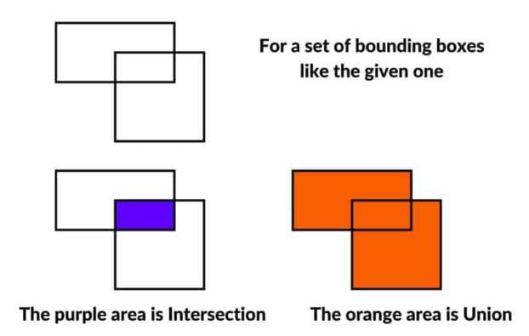
Non Maximum Suppression (NMS)
select best bounding boxes out of many overlapping bounding boxes
remove bbox with score < score_th
sort by score from highest to lowest
while bboxes list is not empty
pop one bbox (B1), for other bboxes (B2), keep in list if
B1 and B2’s predicted class are different
B1 and B2’s predicted class are same and iou(B1, B2) < iou_th
append B1 to final return list
bounding box (bbox)
(class, score, x, y, h, w)
B1
B2

Slide 14
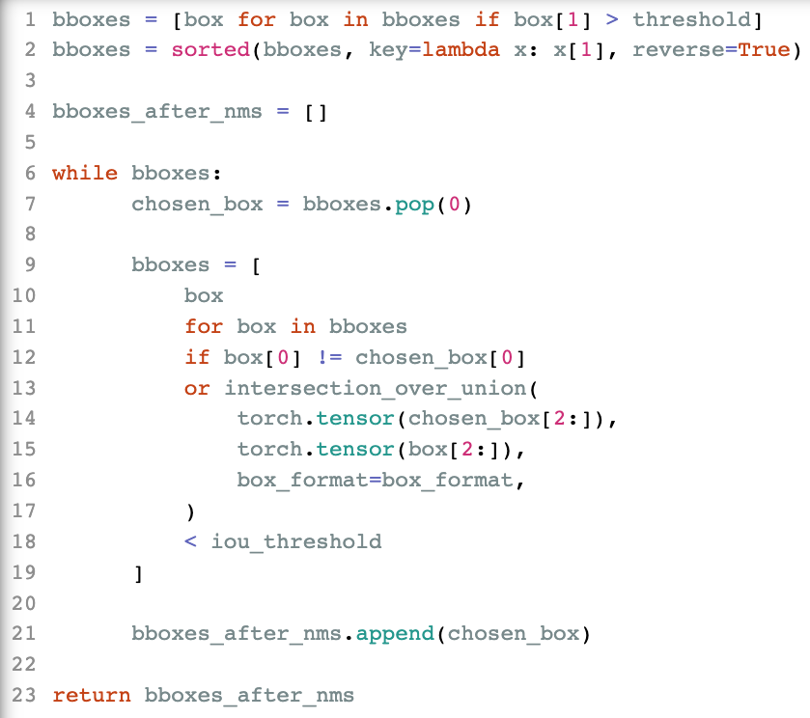
Non Maximum Suppression (NMS)
iou=0.9
iou=0.2
top
C++ array implementation
remain_list
False | False | True | True | True
0.9 | 0.8 | 0.75 | 0.6 | 0.4
0 | 0 | 1 | 0 | 1
scores
nms.py
class_preds
nms.cpp

Slide 15
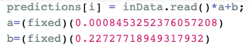
NMS IP (nms.cpp)
hls::stream<fixed>& inData
read_input()
fixed predictions[S*S*(C+B*5)]
cellboxes_to_boxes()
non_max_suppression()

Slide 16
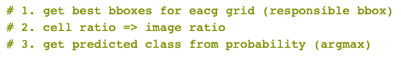
NMS IP (nms.cpp)
hls::stream<fixed>& inData
read_input()
fixed predictions[S*S*(C+B*5)]
cellboxes_to_boxes()
fixed bboxes[S*S*5]
unsigned class_preds[S*S]
non_max_suppression()

Slide 17
NMS IP (nms.cpp)
hls::stream<fixed>& inData
read_input()
fixed predictions[S*S*(C+B*5)]
cellboxes_to_boxes()
fixed bboxes[S*S*5]
unsigned class_preds[S*S]
non_max_suppression()
fixed nms_bboxes[S*S*5]
unsigned nms_class_preds[S*S]
unsigned nms_num

Slide 18
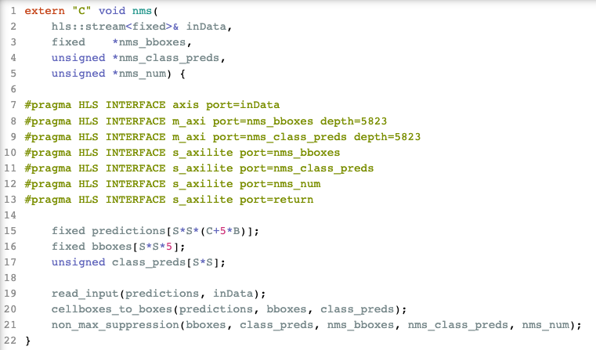
NMS IP (nms.cpp)
hls::stream<fixed>& inData
read_input()
cellboxes_to_boxes()
non_max_suppression()
fixed nms_bboxes[S*S*5]
unsigned nms_class_preds[S*S]
unsigned nms_num

Slide 19
NMS Encountered Problem
cannot use dataflow due to algorithm charcteristic
use stream input then buffer values to perform nms algorithm
cannot synthesize to 10ns if using “float” datatype
due to long latreny of floating point divider (iou = intersection / union)
change datatype to ap_fixed<32, 4>

Slide 20
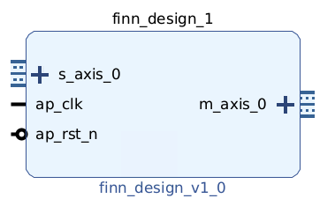
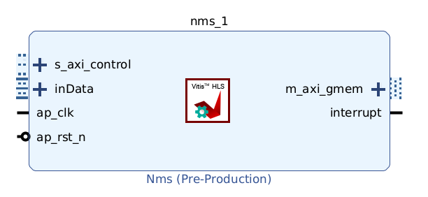
Vivado IP Flow
Since we have NMS block after FINN model, we cannot directly use model’s bitstream
Instead, we get the generated model’s IP and connect it with NMS IP with Vivado tool
How to connect?
YOLO model
NMS

Slide 21
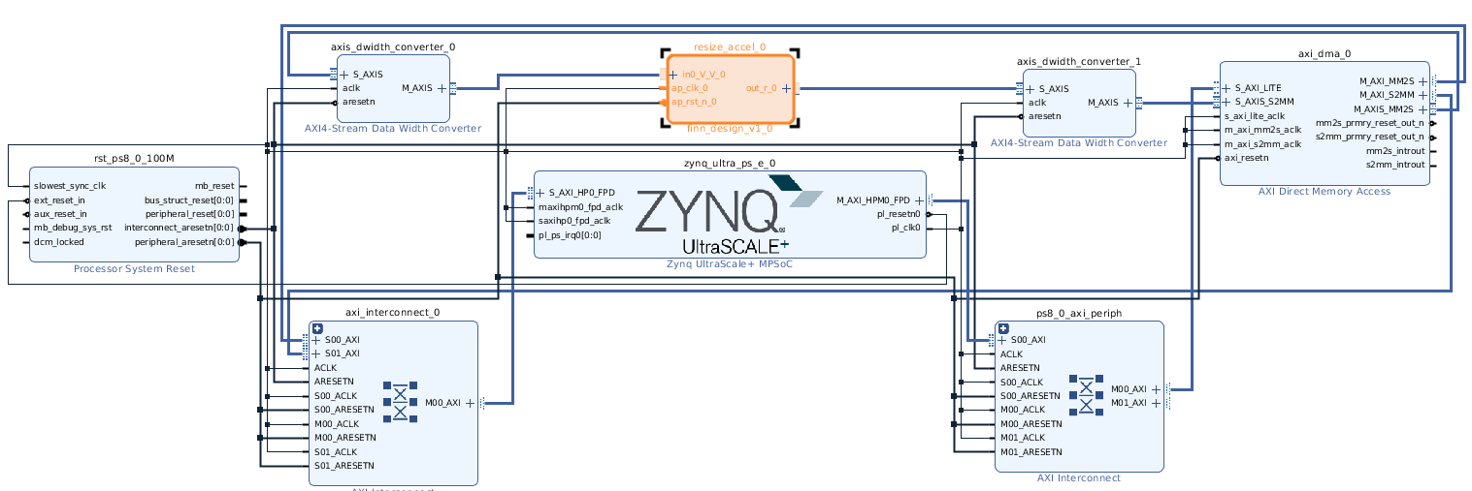
Vivado IP Flow
We refer to “pynq_shell_project.png” in Lab FINN and found we need
ZYNQ, finn_design_v1_0, Nms, DMA, Data Width Converter
finn_design_v1_0
DWC
DWC
DMA
YOLO model
NMS

Slide 22
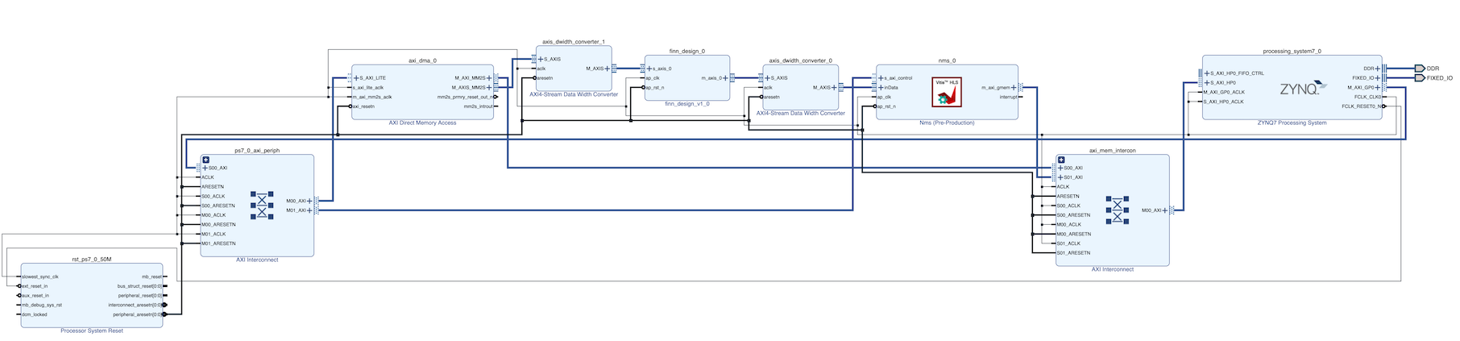
Vivado IP Flow
Our Final Block Diagram
axis
buf
m-axi
4B
DWC
1B
nms
DMA_in
finn
2B
DWC
4B

Slide 23
Host Program
We modify FINN-generated driver.py & driver_base.py to adapt to our new design since it would be challenging to write from scratch

Slide 24
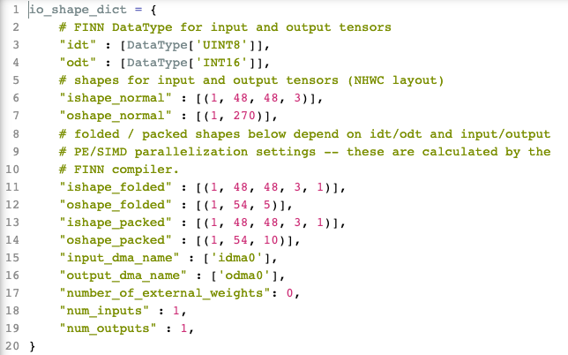
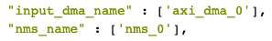
Host Program
driver.py
change to

Slide 25
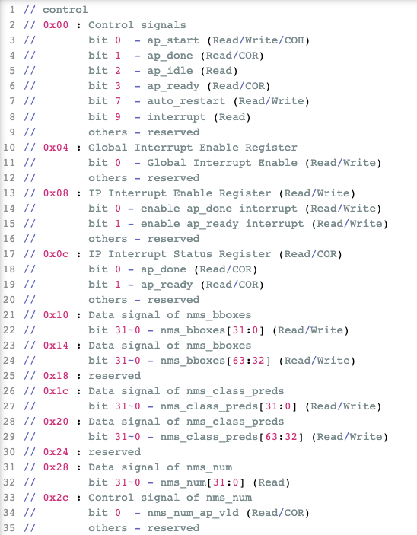
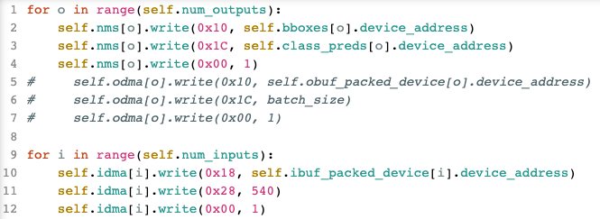
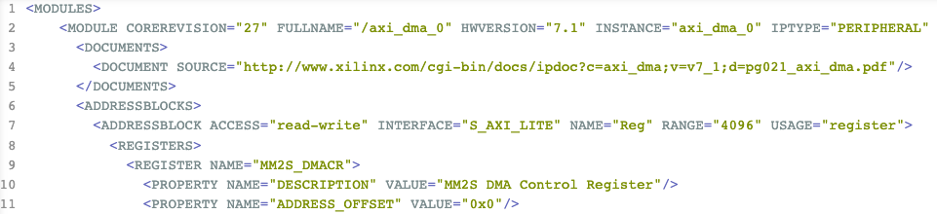
Host Program
xnms_hw.h
driver_base.py
design_1.hwh

Slide 26
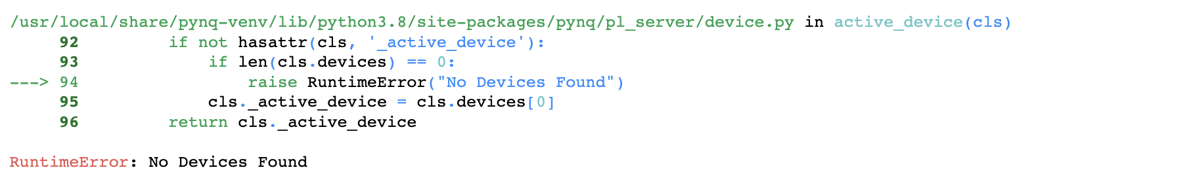
Host Program Encountered Problem
The host program stuck on loading bitstream and we still cannot find a solution
So we currently put nms to PS side…
Pynq board sometimes give “No Devices Found” error

Slide 27
Current System Flow (on PYNQ-Z2)
class,score,x,y,h,w
PS
image preprocessing
NMS
image blending
3xHxW
3xHxW
3x48x48
SxSx(5B+C)
PL
NN model

Slide 28
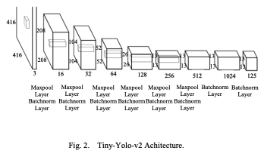
Conclusion
YOLOv1 needs pretrained weights to prevent overfitting, since we modify the model structure, we cannot directly load original pretrained weights, and we don’t have time to pretrain on large dataset like ImageNet, either.
We don’t familiar with how to stitch FINN model and other IPs together, so it is still a major problem to be solved.

Slide 29
Reference
You Only Look Once: Unified, Real-Time Object Detection
LPYOLO: Low Precision YOLO for Face Detection on FPGA
Lightweight CNN Image Classifier with On-chip Preprocessing
Xilinx_QNN-MO-PYNQ_tiny-yolo-image
Fixed Point Implementation of Tiny-Yolo-v2 using OpenCL on FPGA

